Slide 1
Week 39 Report
VISAYAS
September 2015

Slide 2
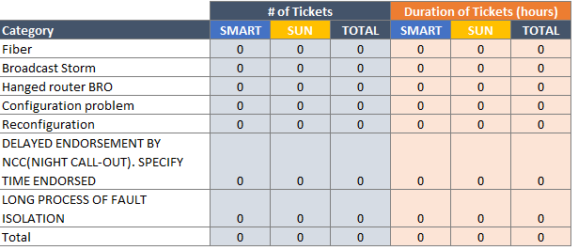
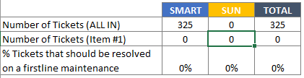
WEEK 39 RAW tickets
Invalid escalation of NOC with estimated time consumed by the team.
*All details based from NOC week39 raw tickets.
Number of Incidents/week.
Notes:
Footnote:
*All details based from NOC raw tickets (always have footnote

Slide 3
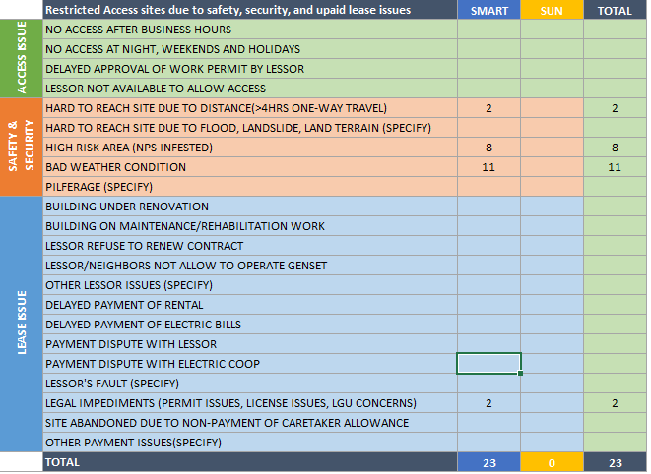
Week 39 RAW tickets
Restricted Access sites due to safety, security, and unpaid lease issues.
*All details based from NOC week39 raw tickets.
Notes:
always have footnote

Slide 4


Week 39 RAW tickets
Repeated Outages of Hubs, Intermediate and last mile sites caused by Passive Infra. (Week 39)
Repeated Outages caused by the build out/Opti issues
Notes:
1 month comparison per repeated outages. 2 or more
Mitigation/innovation. - Not specific.
Regardless of node type

Slide 5
Thank You

